Slide 1



Slide 2


Slide 3
VENTILATION IN
COAL MINE DEVELOPMENT FACE, TUNNEL AND DRIFT

Slide 4
Tunnels or drifts are essentially blind headings till they are connected to shafts or adits thus posing a real challenge to ventilation engineers.
The work place environment in tunnels is greatly influenced by the ventilation method, selection of proper fan and duct apart from cost of ventilation

Slide 5
Ventilation in tunnels and drifts is mainly don by:
Brattice cloths.
Auxiliary Fans and ducts

Slide 6
BRATTICE CLOTH
This is simply a sheet or sheets of canvas commonly made out of treated hessian cloth nailed on to props placed at 1 to 1.5 interval along the heading to prevent the short circuit of air from intake to return, so causing the ventilation air to reach the faces. It may be used:
As a screen across an airway to prevent or reduce the flow of air along it.
As a partition along the roadway to devide it into two parts intake an return
Condition of using Line Brattice:
1. Brattice Cloth coated with P.V.C. is impermeable to airflow, and is more suitable for line brattice to ventilate a heading.
2.This can be used only for a short distance (not more than 20m long) into the heading due to heavy air leakage
3.The intake side of a brattice should be kept wider than its return side. The wider intake will help to circulate adequate quantity of fresh and cool air for the miners at face as well as will faciate easy movement of the men and machineries through it.

Slide 7
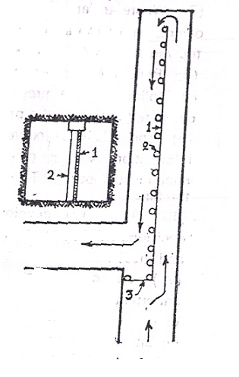
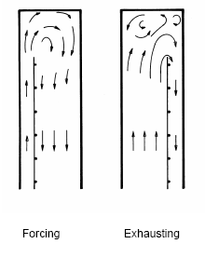
Line Brattices Used for Auxiliary Ventilation

Slide 8
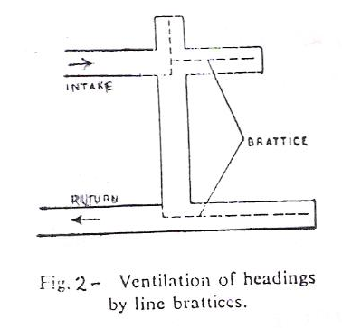

Slide 9
Auxiliary ventilation can be of following types:
Forcing
Exhausting
Overlapping and
Reversible

Slide 10
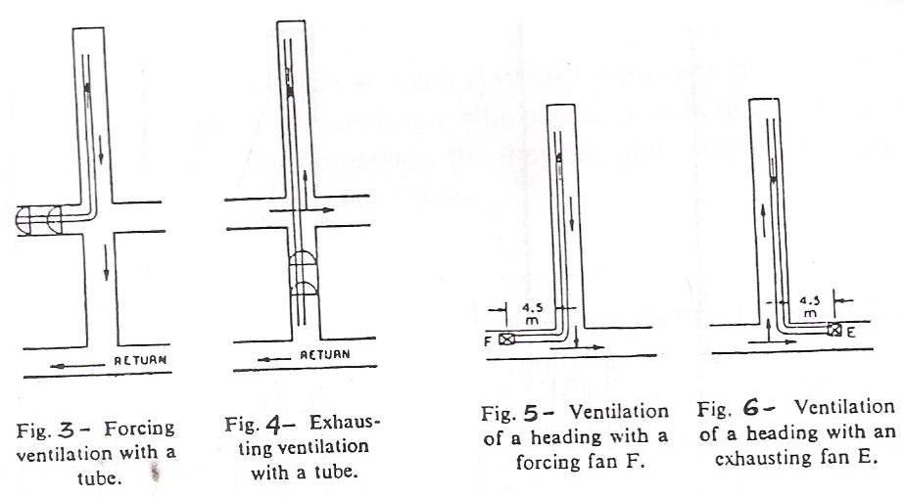

Slide 11
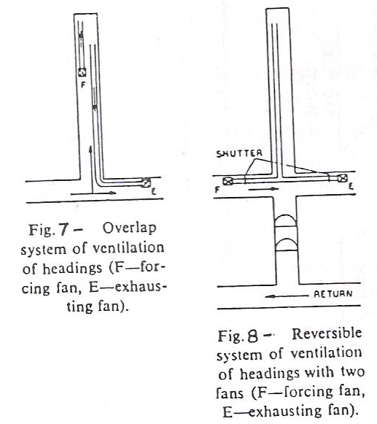

Slide 12
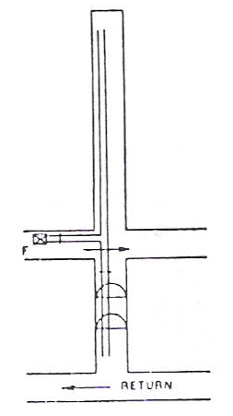
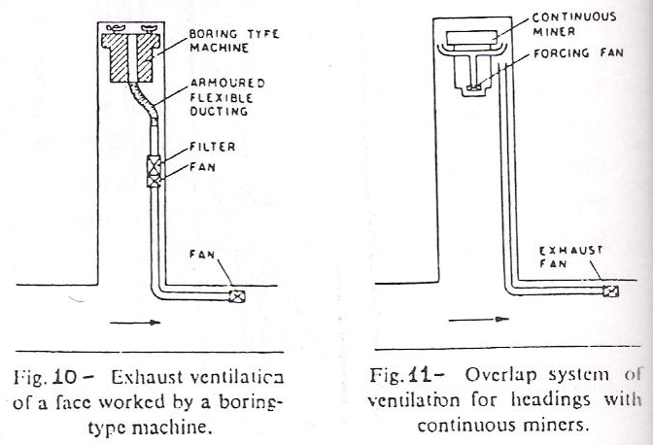
Reversible system of ventilation of headings with a single forcing fan F

Slide 13
Ducts for Auxiliary Ventilation
Purpose:
The efficiency of most of the auxiliary ventilation systems depends more on the proper choice of the duct than the ventilator.
Duct have low co-efficient resistance (0.003-0.005 NS² m⁻⁴)
If length of the is more, the resistance will be more that requires more fan pressure to overcome the frictional pressure loss.
High pressure leads to excessive leakage
New rigid steel ducts if properly jointed and aligned have a coefficient of friction within limit
P.V.C. coated flexible ducting when properly inflated have a fairly low coefficient of friction (upto 0.002 NS² m⁻⁴)
The resistance can be reduced by having large diameter ducts, but such ducts become costly, more difficult to carry and install and take up a large space which is undesirable in headings of small cross-sectional area.
Thus, the choice of proper size of duct, commensurate with the length, is essential.
Ducts for Auxiliary Ventilation
Purpose:
The efficiency of most of the auxiliary ventilation systems depends more on the proper choice of the duct than the ventilator.
Duct have low co-efficient resistance (0.003-0.005 NS² m⁻⁴)
If length of the is more, the resistance will be more that requires more fan pressure to overcome the frictional pressure loss.
High pressure leads to excessive leakage
New rigid steel ducts if properly jointed and aligned have a coefficient of friction within limit
P.V.C. coated flexible ducting when properly inflated have a fairly low coefficient of friction (upto 0.002 NS² m⁻⁴)
The resistance can be reduced by having large diameter ducts, but such ducts become costly, more difficult to carry and install and take up a large space which is undesirable in headings of small cross-sectional area.
Thus, the choice of proper size of duct, commensurate with the length, is essential.
According to NCB, U.K. 104, the use of 450 mm diameter ducts up to a distance of 900 m, beyond which the duct should be of 600 mm.
In India, however, a wide range of duct size s varying from 300 mm to 800 mm are used.

Slide 14
Ducts for Auxiliary Ventilation
Two types of duct are commonly used, the flexible ducts and the rigid ducts
Flexible Ducts
Flexible ducting is much easier to store, transport and install than rigid ducting.
They are cheaper in initial cost, but have shorter life.
Earlier, flexible ducting was made from rubberized cotton fabric, but this material was inflammable and was easily torn.
Now, flexible ducting may be made from terylene, rayon or nylon coated with PVC. Flexible canvas or PVC coated ducting incorporating wire armouring embedded in the fabric is now available for exhaust ventilation.
They are conveniently used in shorter headings up to a distance of 300m, where a more permanent steel ducting become unnecessary or at the face end of rigid duct where they can be easily removed at the time of blasting.
Flexible ducts are very suitable in curved headings.
Flexible duct s are made in longer sections thus reducing the number of joints and consequently the leakage .

Slide 15
Ducts for Auxiliary Ventilation
Two types of duct are commonly used, the flexible ducts and the rigid ducts
Rigid Ducts
Rigid ducts of round section are commonly used for all permanent installations.
They can be made of steel, aluminium, plywood, fibre-glass-reinforced plastic or high-density polythene.
Aluminium ducts are light, have a smooth internal finish resulting in low coefficient of friction, and as well as easy to transport. But, they have not found common use in mines as they are costly and are easily damaged and D-shaped.
Steel ducts are commonly used in every mines and tunnels as permanent because of their sturdiness and long life.
Fibre-glass-reinforced plastic or high-density polythene ducts can also be used in where the air is highly corrosive in nature.
Steel ducts are usually made of hot-rolled mild steel sheets of 1.6 mm thickness, 30 to 75 cm in diameter and 2 to 4 m in length. Different sections are jointed by bolts.

Slide 16
Air requirement in drifts, tunnels and development headings in coal mines
ILO recommended a quantity of 0.175m³ s⁻¹ per m² of the drift face
In extremely hot faces, quantities as high as 0.75 m³ s⁻¹ per m² of the drift face
In coal mines, as per CMR 1957,
  Quantity of air should be 6 m³ min⁻¹ per man or 2.5 m³ min⁻¹ per daily tonne output, which ever is larger, passes along the last ventilation connection in the district
  At every active working place in the mine, air does not contain less than 19% of oxygen or more than 0.5% of carbon dioxide or any noxious gas in quantity likely to affect the health of any person
  The percentage of inflammable gas does not exceed 0.75 in the general body of the return air 1.25 in any place in the mine
  The WBT in any working place does not exceed 33.5 ⁰C and if it exceeds 30.5 ⁰C, arrangement should be made to ventilate the same with a air velocity of no less than 1 m/s

Slide 17
Air requirement in drifts, tunnels and development headings in coal mines
In long heading, the quantity required to be circulated is controlled chiefly by the need to quickly remove the blasting fumes from the drift face in order to minimize loss of working time.
The DGMS, India requires the ventilation of drive exceeding 50m in length to be such as to dilute the nitrous fumes produced by blasting to 5 p.p.m. and CO to 50 p.p.m. within a period of five minutes.
Considering a diluting time t, the required rate of air-flow can be obtained from the gas balance equation for time t.
q M q/
Q = ------ OR Q = ------ ------- Eqn 1
c t c t
where,
Q = quantity of air flow (m³ min⁻¹),
q = amount of gas added during time t = M q/,
M = mass of explosive blasted,
q/ = volume of noxious gas produce per unit mass of explosive,
c = concentration at time t.

Slide 18
Air requirement in drifts, tunnels and development headings in coal mines
In long tunnels however, mixing and dilution occurs over a short length at the face in front of the ventilation tube. In such case it would be more logical to use the following relation:
V_{m} q V – V_{m}
t = 2.303 ------ log ------- + --------- -------- Eqn 2
Q V_{m} c Q
where,
Q = quantity of air flow (m³ min⁻¹),
q = total volume of noxious gas produced at time t = M q/,
V =volume of tunnel
V_{m} = volume of tunnel over which mixing of gases produced at the face and air delivered by the fan occurs,
c = concentration at time t.

Slide 19
Air requirement in drifts, tunnels and development headings in coal mines
Problem: 1
18 kg of explosive is fired in a 2m x 2.5m drive which is 1000 m long. Calculate the quantity of air to be circulated by an auxiliary fan to bring down the concentration of nitrous fumes in the drive to the tolerable limit of 5 p.p.m. within a period of 5 minutes. A kg of explosive produces 2000 cm³ of nitrous fumes.
Problem: 2
16 kg of explosive is fired in a 2m x 2.5m drive which is 1200 m long. Calculate the quantity of air to be circulated by an auxiliary fan to bring down the concentration of carbon dioxide fumes in the drive to the tolerable limit of 50 p.p.m. within a period of 5 minutes. A kg of explosive produces 2500 cm³ of nitrous fumes.

Slide 20
Air requirement in drifts, tunnels and development headings in coal mines
Solution (Problem 1):
The volume of the drive = 2x2.5x1000 = 5000
The volume of nitrous fumes produced = 18 x 2000 cm³ = 36000 cm³ = 0.036 m³
maximum permissible concentration of gas = 5 p.p.m. = 0.005%
Assuming the ventilation tube to discharge at a point 10 m away from the face.
Therefore, the mixing volume V_{m} can be taken equal to 10 x 2 x 2.5 = 50 m³
Now using equation 2,
50 0.036 5000 – 50
5 = 2.303 ------ log ---------------- + ---------------
Q 50 x 0.0005 Q
or, Q = 993.648 m³ /min = 16.56 m³ /s
Therefore, quantity of air required to be circulated by an auxiliary equals to 16.56 m³ /s

Slide 21

Thank You

